Slide 1


MELODY TUNES
sounds that make you move!!!!!
A C++ project for 1st year/ second semester students
Bachelor’s in Electronics,Communication and Information Enginnering

Slide 2





Meet Our Team
Abhishek Niraula Saubhagya Rajbhandari
Prashan Chenta Rai 080BEI030
Sneha Karna 080BEI042
080BEI004
Team
leader/Presenter
080BEI039

Slide 3




MELODY TUNES
is a music player system developed as a part of assessment for the second semester electronics /computer engineering students by ACES.
Our Features:
GUI based approach to a music player system.
Admin level control and user level access.
Involves play, pause, stop, skip, rewind options as well as volume control.
Intuitive and user-friendly.
Multi functional use of file handling and strutures.

Slide 4
User Login Features
Allows users to choose between logging in as a Musician or a Listener.
Musicians can add new songs to their list, providing details like song name, file path, and duration.
Musicians can view and save their song collection, showing details such as song name, musician name, file path, and duration.
Musician Features
Listeners can:
Add Songs: Add songs to their personal collection. View File Path: Find the file path of a specific song. Delete Songs: Remove songs from their collection.
Add to Favorites : Mark songs as favorites.
View Favorites: See a list of favorite songs with details.
Listener Features

Slide 5
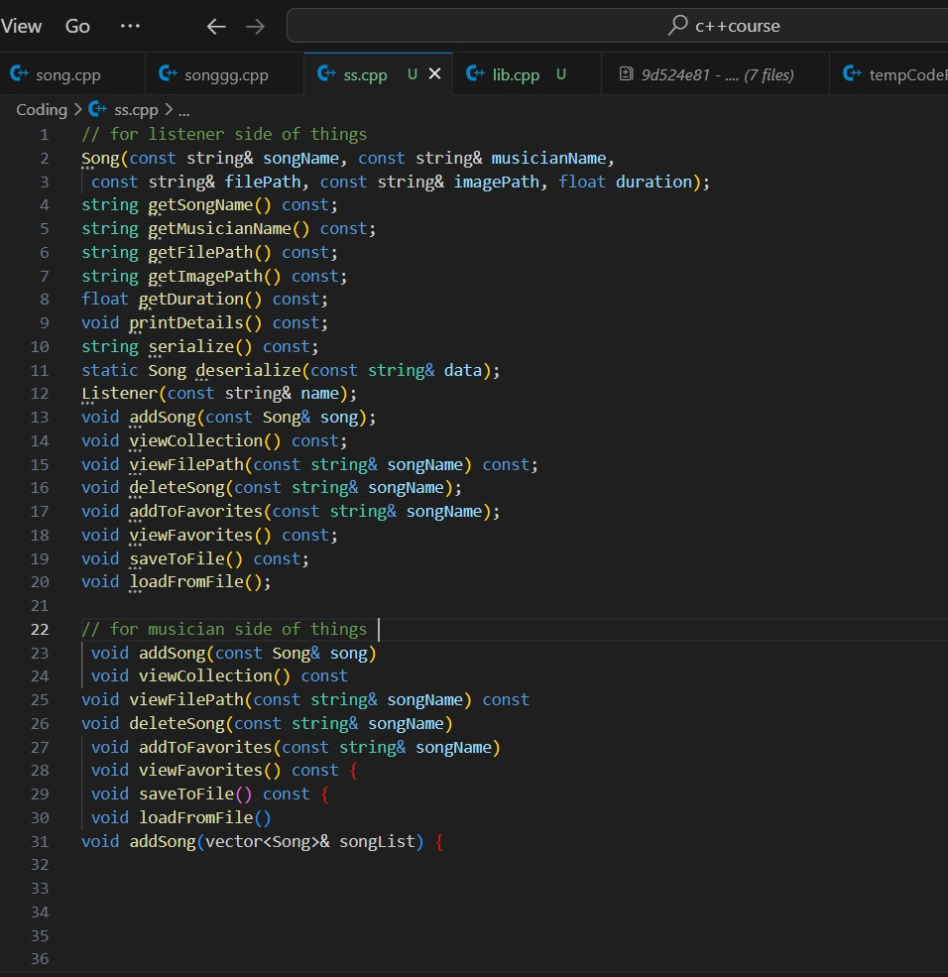
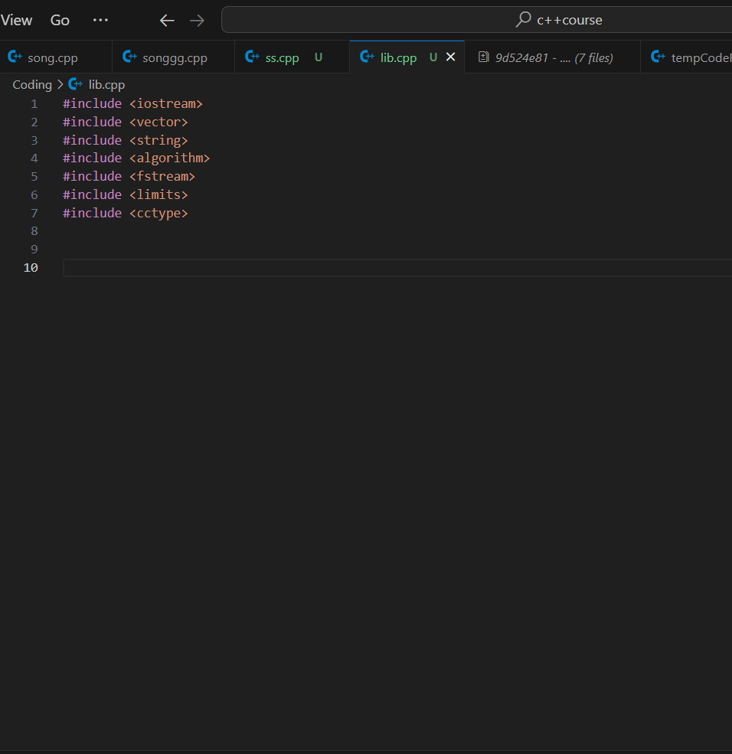
Function Prototype
Standard Libraries

Slide 6
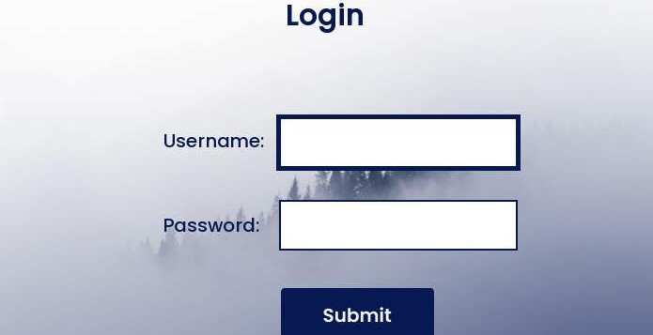
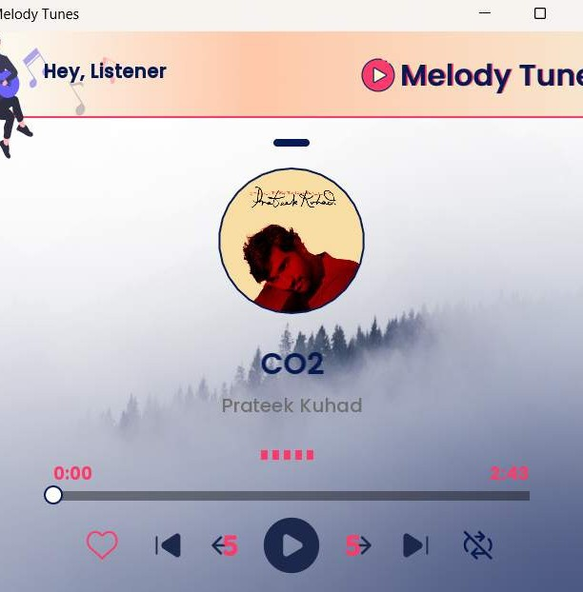
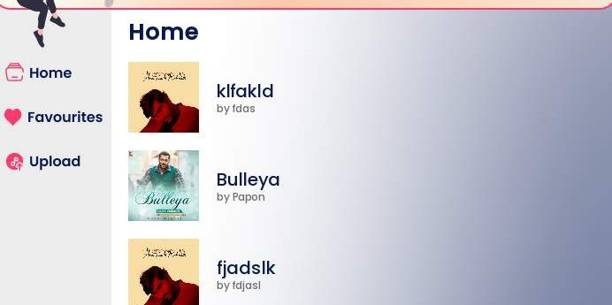
PROGRAM OUTPUT

Slide 7






CONCLUSION AND TAKEAWAYS:
This project provides a comprehensive exercise in object oriented programming, file handling and user interface design.
It not only enhances coding skills but also offers practical insights into software development processes.
REFERENCES:
Use of AI programs to understand project workflow and internal logics for some part.
www.github.com

Slide 8







Thank You!

